Slide 1

Superhero U Facebook Ad Campaign Analysis & Recommendations

Slide 2

Project Objective
Analyze
Analyze Facebook ad campaigns for the SuperheroU event to:
Identify
Identify top-performing campaigns
Detect
Detect underperforming campaigns
Recommend
Recommend actions for future campaigns

Slide 3

EXPLANATION OF SUPERHERO U EVENT
Superhero U is an event organized by GlobalShala, designed to engage audiences in educational, personal development, and global community-building activities. The event leverages digital marketing, particularly Facebook Ads, to reach diverse student audiences across multiple countries.

Slide 4
Explanation of Facebook Ads
Facebook Ads were employed to:
Facebook Ads are a digital advertising tool that allows businesses to target specific demographics based on location, interests, behaviors, and more.
For Superhero U
Increase event awareness.
Drive registrations and engagement.
Optimize budget spending across global markets. Key Metrics Analyzed:
Click-Through Rate (CTR)
Cost Per Click (CPC)
Cost Per Result (CPR)
Reach Impressions

Slide 5



OVERVIEW OF ALL SUPERHERO U AD CAMPAIGNS
Multiple Facebook ad campaigns were launched targeting students in different countries, including:
SHU Students (Australia)
SHU Students (UK)
SHU Students (UAE)
Other regions (not specified)
Each campaign's performance was assessed using advanced data visualization techniques and
Python-based analytics.

Slide 6
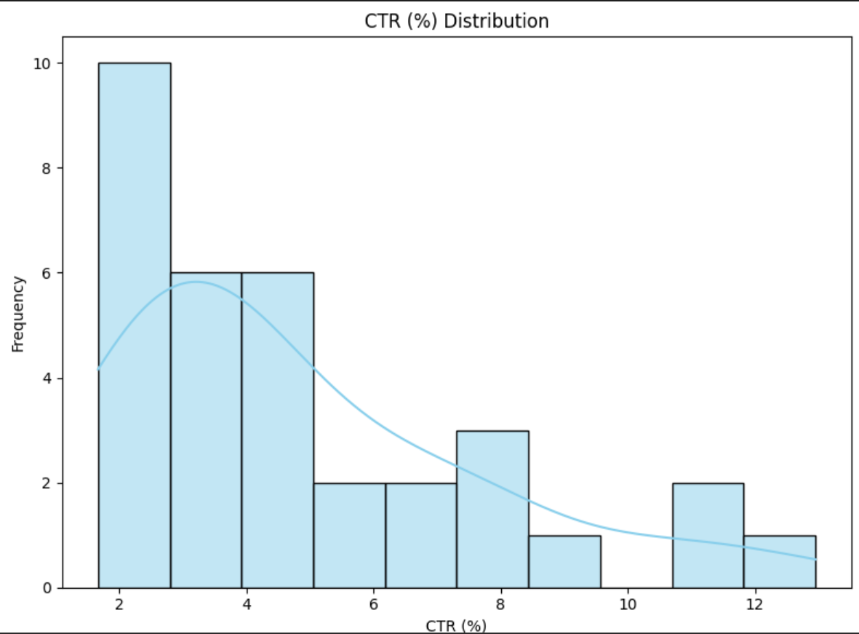
CTR (%) Distribution Analysis
Most campaigns have a CTR between 2% and 5%.
A few campaigns achieved higher CTRs, above 8%.
The distribution is right-skewed, showing fewer high-performing campaigns.
This indicates that only a small number of ads are driving strong engagement.

Slide 7
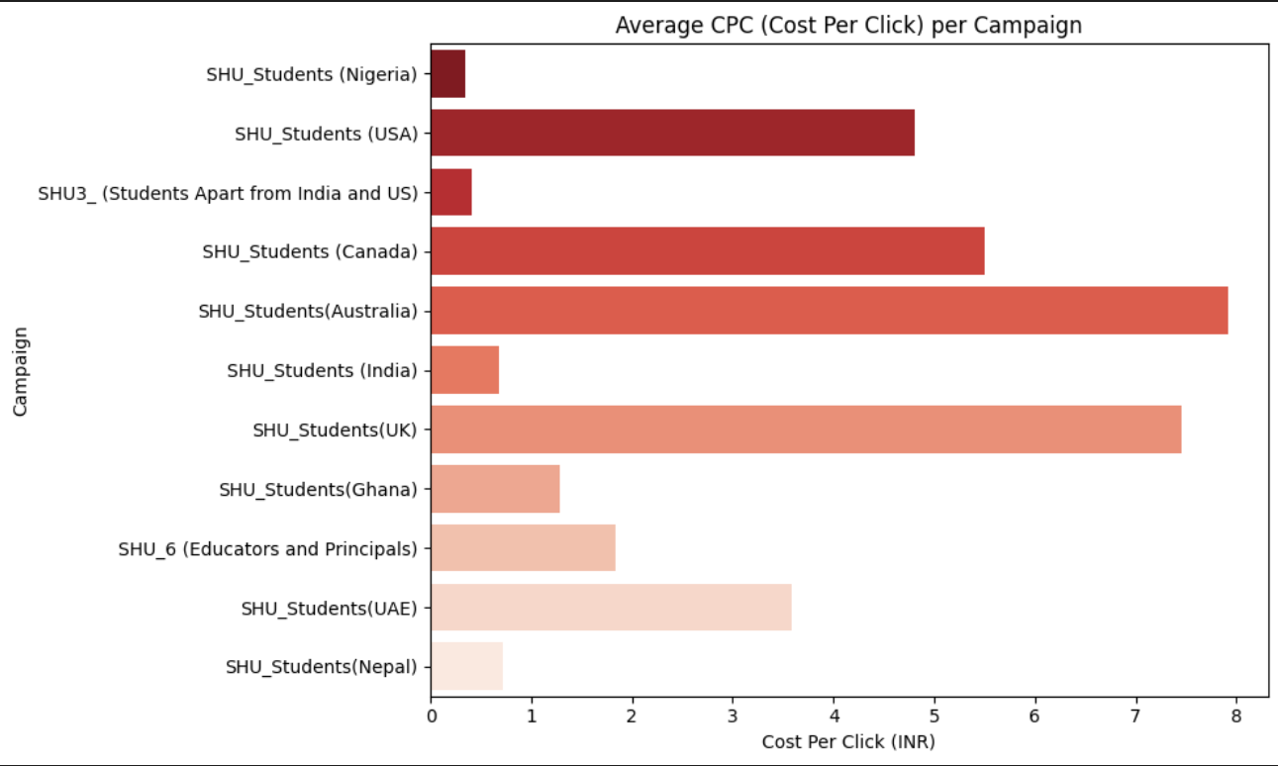
Average CPC (Cost Per Click) by Campaign
Lowest CPC in:
Nepal (~₹0.5)
India (~₹1.1)
Other Regions (~₹1.0)
Highest CPC in:
Australia (~₹7.8)
UK (~₹7.2)
Canada (~₹6.0)
Significant cost differences across regions
High CPC suggests lower efficiency or more competition
Low CPC indicates better cost-effectiveness

Slide 8


Explanation of Campaigns Recommended for Discontinuation
Cost Per Click (CPC):
High CPC for Australia and UK indicated inefficient budget utilization.
Cost Per Result (CPR):
High CPR for Australia and UAE campaigns demonstrated poor cost efficiency.
Reach vs Impressions:
Limited reach combined with high impressions pointed to ineffective audience engagement.
Frequency vs Clicks:
High exposure but low click rates indicated ad fatigue and diminishing returns.
Based on our analysis, we recommend discontinuing the following campaigns:
SHU Students (Australia)
SHU Students (UK)
SHU Students (UAE)
Supporting Data Visualizations & Key Findings:

Slide 9






Conclusion
Through comprehensive analysis of key performance indicators and visual data analytics, we determined that the SHU Students (Australia), SHU Students (UK), and SHU Students (UAE) campaigns underperformed significantly.
These campaigns exhibited high costs, limited audience engagement, and signs of ad fatigue.
Discontinuing these campaigns will allow GlobalShala to reallocate the advertising budget towards more effective markets, improving overall ROI and campaign efficiency.

Slide 10

Thank you

